Slide 1
Fairness characteristics of Active Learning strategies in RecSys

Slide 2
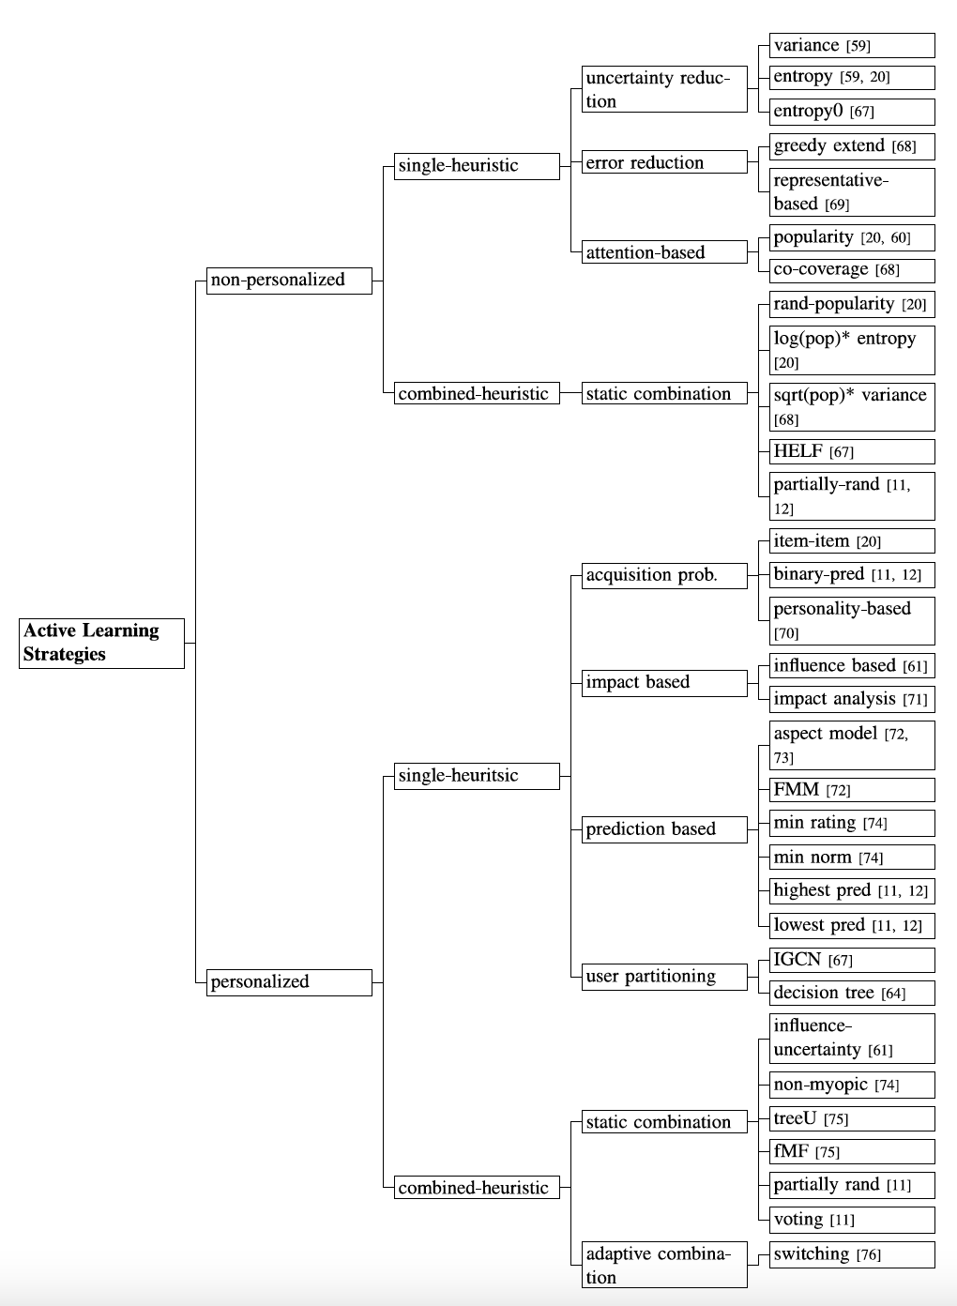
Classification of AL Strategies in Collaborative Filtering

Slide 3
Active Learning Strategies Implemented
Sensitive Attribute
Gender
273 protected users (women) and 670 unprotected users (men)
Attention- based
Popularity
SQRT(Popularity)*Variance
Uncertainty-based
Variance
We have 16 trials
Everytime we pick [1, 5000, 10000, 15000, 20000, 25000, 30000, 35000, 40000, 45000, 50000, 55000, 60000, 65000, 70000, 75000, 80000] data points
Randomly
According to the AL strategy

Slide 4
Attention Based AL - popularity
Attention-based: This group of strategies focus on selecting the items that have received the highest “attention” among the users. Such items are likely to be known by the users, and therefore they can be rated by them. Hence, these strategies usually add a lot of ratings. These strategies are simple and easy to implement and they were introduced in the initial attempts to solve the cold start problem in collaborative filtering. They are considered as baseline strategies
Popularity: selects the most popular items, i.e., those with the highest number of ratings. It is very likely that the users are able to rate these items and consequently the size of the rating dataset can be increased. However, popular items are typically widely liked by the users. Therefore, their ratings usually bring little information to the system. Moreover, this strategy may cause the prefix bias, i.e., the system trained with ratings for popular items tend also to recommend these popular items, making them even more popular.
SQRT(Popularity) * Variance This is a “balanced” strategy as it tries to collect many ratings but also taking into account their relative informativeness. This is achieved by scoring an item with the square root of the popularity multiplied by the variance of the item’s ratings. The distribution of the items’ popularity is exponential while the distribution of the variance is more similar to a normal distribution. Indeed, there is a huge difference among the popularity scores of few popular and many unpopular items. multiplying variance and popularity reduces the weight of popularity. Therefore we end up with items that are popular and at the same time have controversial ratings.

Slide 5
Uncertainty Reduction Based AL - Variance
Uncertainty-reduction are popular strategies that select items with controversial or diverse ratings. The system is supposed to be more uncertain about the users’ opinion about them and asking a user to rate such items can bring useful (discriminative) information about the user’s preferences.
this strategy selects the items with the highest variance, hence, it favours the items that have been rated diversely by the users on the assumption that the variance gives an indication of the uncertainty of the system about that item’s ratings :
𝑉𝑎𝑟𝑖𝑎𝑛𝑐𝑒(𝑖)=1/|𝑈𝑖|∑𝑢∈𝑈𝑖(𝑟𝑢𝑖−¯𝑟𝑖)2

Slide 6
Non-personalized AL
The previous methods are all non-personalized!
Simpler active learning strategies do not take into account users’ previously expressed ratings and request all the users to rate the same items.
We refer to these strategies as non-personalized. In this case, the heuristic used for item selection does not depend on the profile of the individual users.

Slide 7
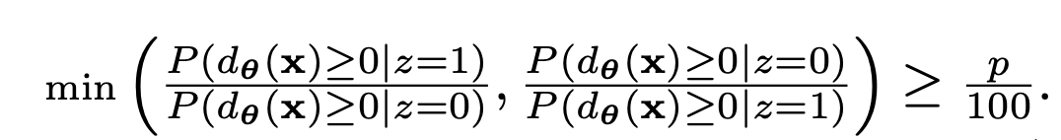
Consumer-side Fairness Metrics
implemented
Non-parity
Value unfairness
Absolute unfairness
Underestimation
Overestimation
Group based RMSE
To be implemented
Calibration (KL-divergence between the distribution of user profile and her recommendation)
Statistical Parity / Demographic Parity - approx. P₀ [C=1]/P₁ [C=1] ≥ 1-ϵ
P% rule (a variation of SP)
Notes:
SP
Having the same acceptance rate
Ppr
if the ratio between the percentage of users with a particular sensitive attribute (z=1) value having dθ(x) ≥ 0 and the percentage of users without that value having dθ(x) ≥ 0 is no less than 80:100 (p:100).
Given a binary sensitive attribute z ∈ {0, 1}, & dθ∗ (x) denotes the signed distance from the feature vector x to the decision boundary.

Slide 8
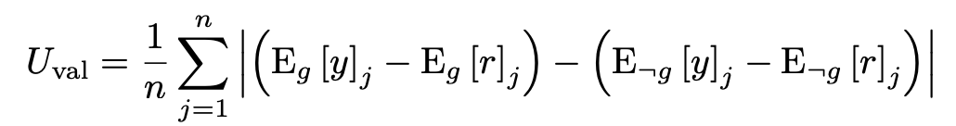
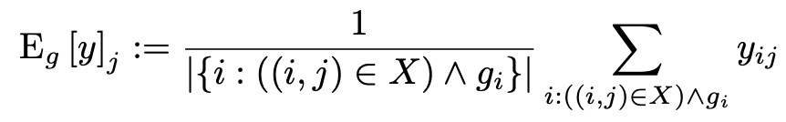
C-Fairness
Value Unfairness
where Eg [y] j is the average predicted score for the jth item from disadvantaged users, E¬g [y] j is the average predicted score for advantaged users, and Eg [r] j and E¬g [r] j are the average ratings for the disadvantaged and advantaged users, respectively.
Notes:
Value unfairness occurs when one class of user is consistently given higher or lower predictions than their true preferences. If the errors in prediction are evenly balanced between overestimation and underestimation or if both classes of users have the same direction and magnitude of error, the value unfairness becomes small. Value unfairness becomes large when predictions for one class are consistently overestimated and predictions for the other class are consistently underestimated. For example, in a course recommender, value unfairness may manifest in male students being recommended STEM courses even when they are not interested in STEM topics and female students not being recommended STEM courses even if they are interested in STEM topics.
Source:
Beyond Parity: Fairness Objectives for Collaborative Filtering
https://papers.nips.cc/paper/2017/file/e6384711491713d29bc63fc5eeb5ba4f-Paper.pdf

Slide 9
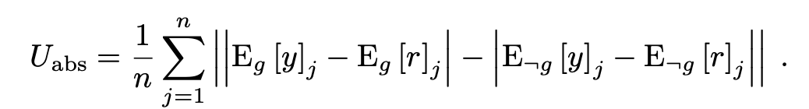
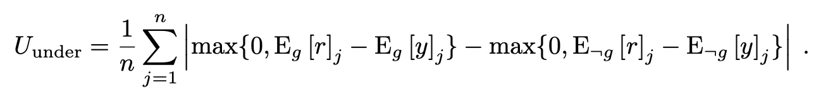
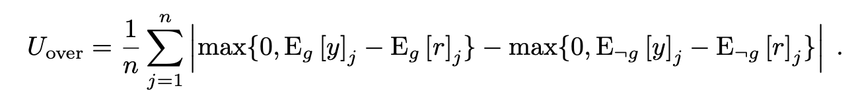

C-fairness
Absolute unfairness
Under-estimation
Over-estimation
non-parity
Notes:
Absolute unfairness is unsigned, so it captures a single statistic representing the quality of prediction for each user type. If one user type has small reconstruction error and the other user type has large reconstruction error, one type of user has the unfair advantage of good recommendation, while the other user type has poor recommendation. In contrast to value unfairness, absolute unfairness does not consider the direction of error. For example, if female students are given predictions 0.5 points below their true preferences and male students are given predictions 0.5 points above their true preferences, there is no absolute unfairness. Conversely, if female students are given ratings that are off by 2 points in either direction while male students are rated within 1 point of their true preferences, absolute unfairness is high, while value unfairness may be low.
Underestimation unfairness is important in settings where missing recommendations are more critical than extra recommendations. For example, underestimation could lead to a top student not being recommended to explore a topic they would excel in.
Overestimation unfairness may be important in settings where users may be overwhelmed by recommendations, so providing too many recommendations would be especially detrimental. For example, if users must invest large amounts of time to evaluate each recommended item, overestimating essentially costs the user time. Thus, uneven amounts of overestimation could cost one type of user more time than the other.
Nonparity is the absolute difference between the overall average ratings of disadvantaged users and those of advantaged users

Slide 10
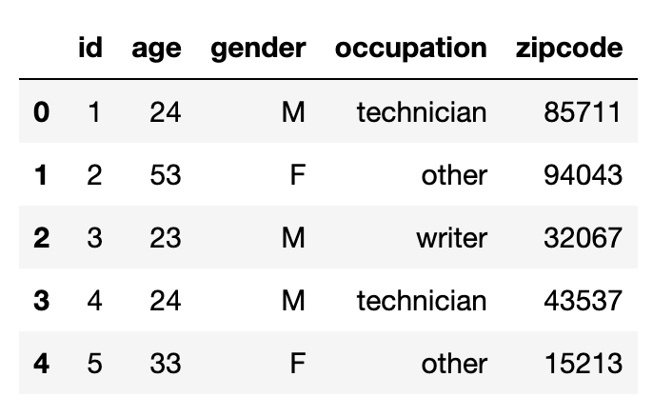
Dataset
MovieLens 100k
100,000 ratings (1-5) from 943 users on 1682 movies.
Each user has rated at least 20 movies.
user id | item id | rating | timestamp
Movies have 19 genres
movie id | movie title | release date | video release date | IMDb URL | unknown | Action | Adventure | Animation | Children's | Comedy | Crime | Documentary | Drama | Fantasy | Film-Noir | Horror | Musical | Mystery | Romance | Sci-Fi | Thriller | War | Western |
Demographic information about the users;
user id | age | gender | occupation | zip code

Slide 11
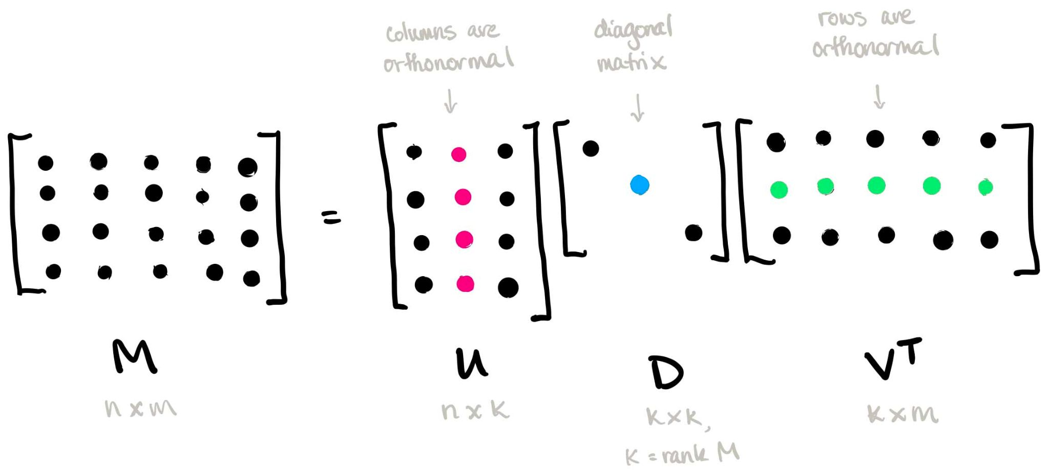
Recommendation Algorithm: SVD
Recsys algorithm = Singular Value Decomposition (SVD)
Notes:
M=input data
U=left singular vector (columns orthonormal) - user to concept similarity
V=right singular matrix (columns orthonormal) - movie to concept similarity matrix
D=diagonal matrix (shows the strength of “concepts”) and the values are all non-zero and positive and in decreasing order
K: concepts and rank of matrix M

Slide 12
Results

Slide 13
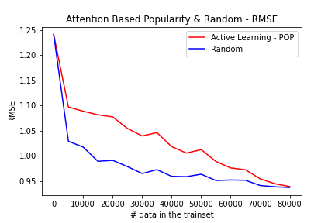
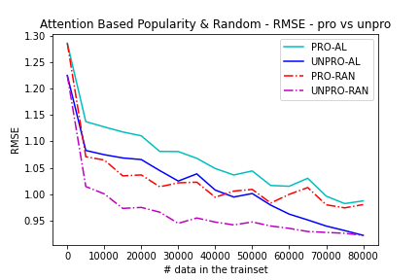
AL - attention based popularity - big gaps
Test set is selected randomly at each iteration.
Notes:
The more we collect data, the smaller RMSE.
The random method has a lower RMSE. Here, each time we pick 500 samples with the highest popularity.
Why does it have lower RMSE?
The gap starts to seperate, but it converges at the end, because the dataset becomes similar as we gather more data.
The protected group has a higher RMSE in general than the unprotected. The unprotected group in active learning has similar RMSE to the protected group in the random strategy.

Slide 14
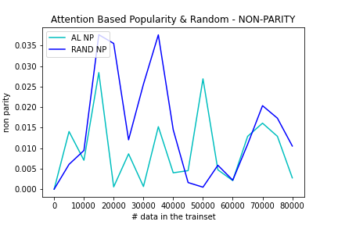
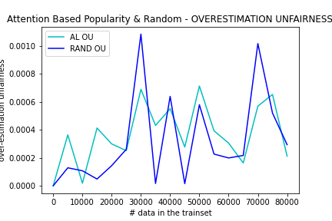
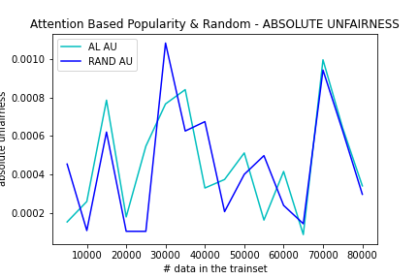
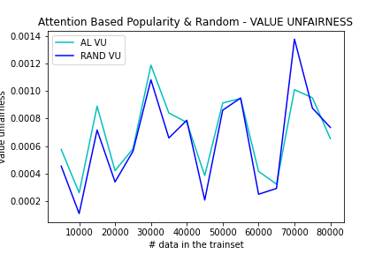
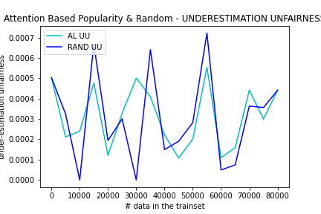
Test set is selected randomly at each iteration.
Notes:
Nonparity is the absolute difference between the overall average predicted ratings of the advantaged minus the disadvantaged. 0 is perfect. If we overestimate the ratings of any of the groups, nonparity increases.
In the nonparity plot, in the first 5000, the random strategy has a lower nonparity. For the most parts except the beginning and the end of the plot, active learning has a lower nonparity or equal non parity.
Although the active learning strategy has a higher RMSE, the nonparity measure is lower. We still have a lot of fluctuations.
========
Value unfairness becomes large when predictions for one class are consistently overestimated and predictions for the other class are consistently underestimated. If the error for both groups is high, it becomes small!!!! (wrongly)
Value unfairness is similar for both methods. The random method is slightly smaller than the AL method.
Are the recommendations close to the tru ratings? Are we providing groups with a similar quality of recommendations?
Interesting enough, the value unfairness has increased slightly in general.
=========
Absolute fairness captures the quality of recommendations. Are the errors that users experience balance in both groups? Is one group getting better recommendations than the other group?
Both random and AL act similarly. Random is slightly lower.
=========
Generally overestimation error is lower in the active learning strategy and the random strategy has a lot of fluctuations.
Over estimation also is increasing slightly at the end.
=========
Underestimation has a lot of fluctuations! In general AL has more consistently low values.

Slide 15
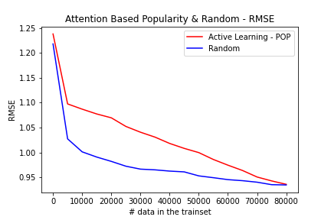
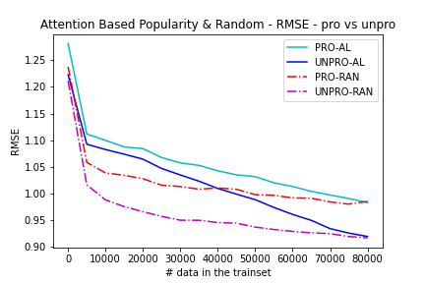
Test set is kept fixed!
It changed a lot from the previous situation!!!
Notes:
The plots are way smoother, but they have the same trend and range.
I choose to take the test set fixed then!

Slide 16
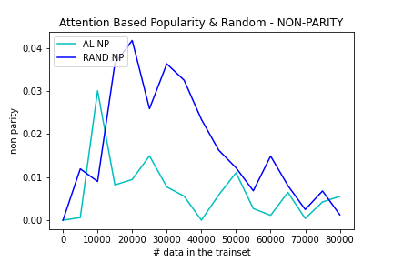
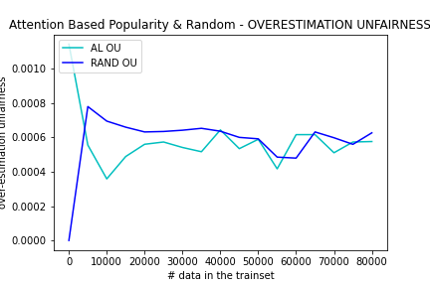
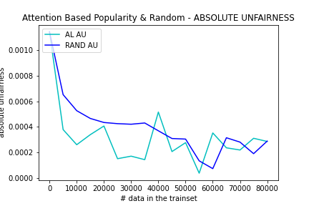
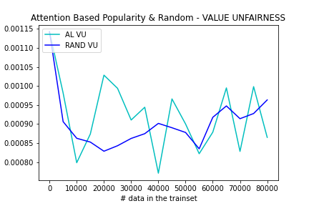
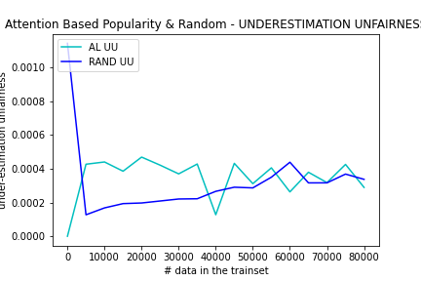
Test set is kept fixed!
It changed a lot from the previous situation!!!
Notes:
Many of these trends now changed! The fluctuations reduced to a great extend!
Active Learning strategy is performing somehow better in most case and has more consistent values than the random strategy.
Underestimation error is although higher than the random case! And the value unfairness still has fluctuations!

Slide 17
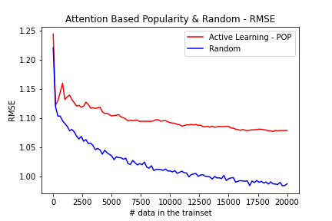
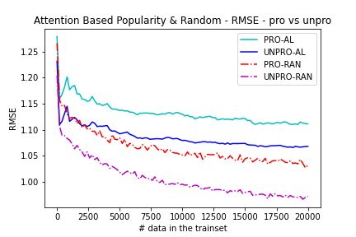
AL - attention based popularity - medium gaps

Slide 18
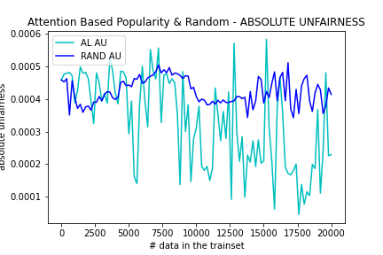
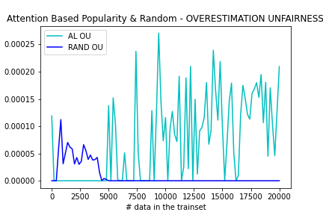
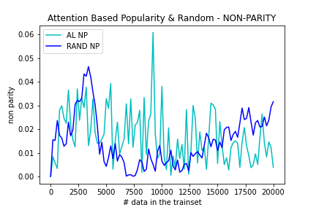
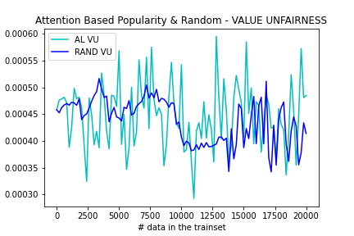
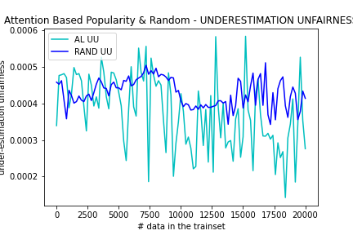
AL - attention based popularity - medium gaps

Slide 19
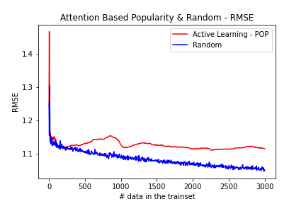
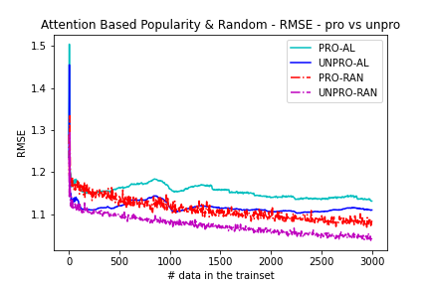
AL - attention based popularity - small gaps

Slide 20
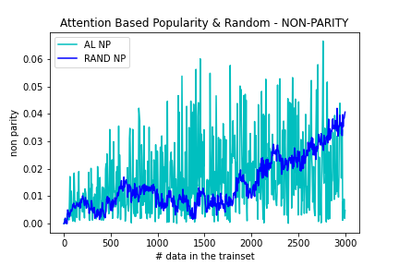
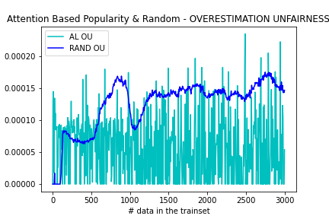
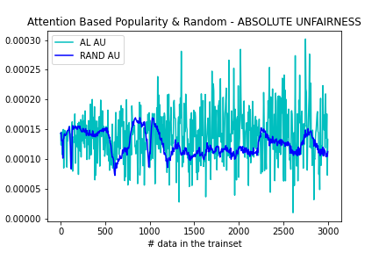
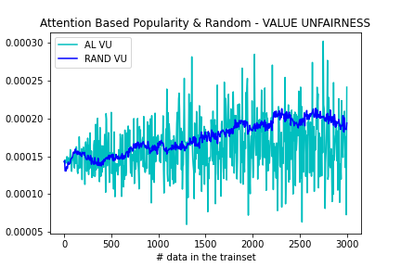
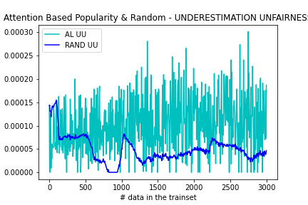
AL - attention based popularity - small gaps

Slide 22
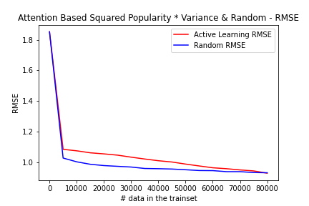
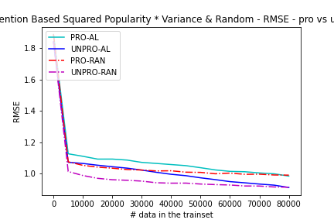
AL -attention based sqrt(popularity)*variance - big gaps

Slide 23
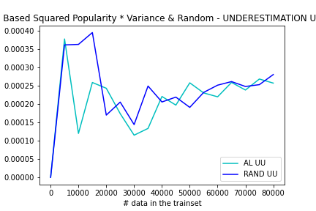
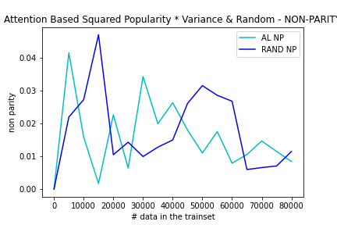
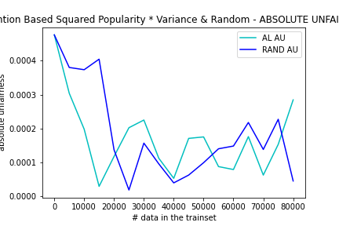
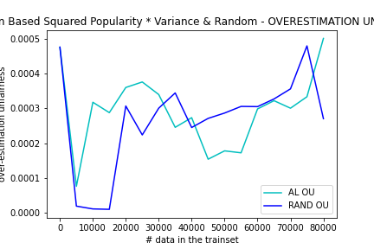
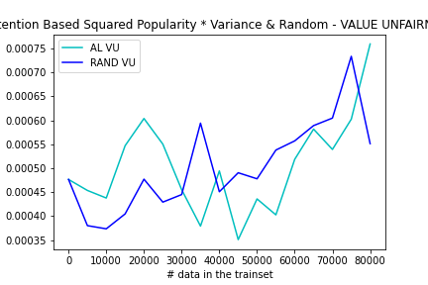
AL -attention based sqrt(popularity)*variance
Big gaps

Slide 24
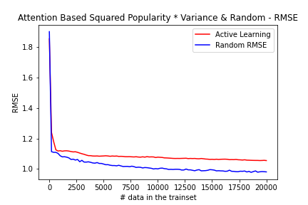
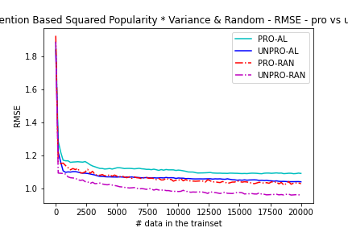
AL -attention based sqrt(popularity)*variance - med gaps

Slide 25
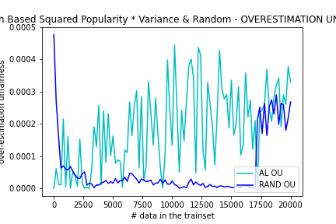
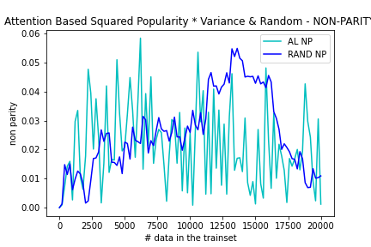
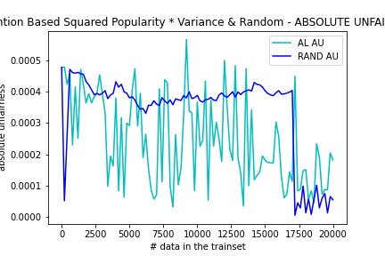
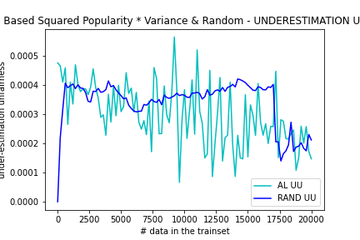

AL -attention based sqrt(popularity)*variance - med gaps

Slide 26


AL -attention based sqrt(popularity)*variance - sm gaps

Slide 27





AL -attention based sqrt(popularity)*variance - med gaps

Slide 29


AL - uncertainty reduction based - variance - big gaps

Slide 30





AL - uncertainty reduction based - variance - big gaps

Slide 31


AL - uncertainty reduction based - variance - medium gaps

Slide 32





AL - uncertainty reduction based - variance - medium gaps

Slide 33


AL - uncertainty reduction based - variance - small gaps

Slide 34





AL - uncertainty reduction based - variance - small gaps

